Slide 1
Introduction to
RAIL

Slide 2
What is Rail?
Trains
Stations
Staff
Customers
Infrastructure
Industry Structure
Notes:
Text book definition of Rail is the conveyance of passengers and goods on wheeled vehicles running on rails
But Rail is more than just trains and tracks on the ground
History:
Rail is an industry, which has stood the test of time, Mother Nature and two World Wars Huge sacrifices and great acts of heroism were performed by rail workers in the Second World War effort including their vital part to ensuring the success of the Dunkirk evacuation where 327 special trains moved tens of thousands of soldiers from Channel ports
In 1994 it was the vision of the rail industry that delivered the Channel Tunnel connecting the UK to mainland Europe
Rail has achieved the longest sustained growth in history Today’s network delivers 16 billion passenger journeys a year Our passenger growth in the UK is greater than all other European countries, including France, Germany and the Netherlands Rail provides more than 200,000 UK jobs, with around 40 % of those in the supply chain and that number continuously rises
Industry Structure:
Will be discussed at a later slide
Infrastructure:
The rail infrastructure in the UK is complex and comprises of a number of different bodies
Not only does it regulate the mainline railway, It is also the health and safety regulator for a number of other forms of transport that run on rail
Consists of
Mainline Network:
The overall picture of who owns and operates on the UK Railway network
Underground Railways
Light Rail and tramways
Minor and Heritage Rail
Cross Rail infrastructure

Slide 3
A Trip Down Memory Lane
Source: Network Rail
Notes:
1804 : The first successful steam locomotive(Richard Trevithick’s Penydarren) runs on wheels and is used to transport iron across nine miles of track
1807: The first passenger carrying public railway is opened by the Oyster mouth Railway It uses horse drawn carriages on an existing tramline
1812: The first successful steam powered commercial locomotive – the Salamanca– is built by John Blenkinsop and Matthew Murray for the Middleton Colliery Railway
1825: The first public railway in the world to use steam power is opened at the Stockton and Darlington Railroad by George Stephenson The railway moves 36 wagons of his steam-powered coal train ‘Locomotion
1829: George and Robert Stephenson’s locomotive, ‘The Rocket’, sets a speed record of 47 km/h(29 mph) at the Rain hill Trials held near Liverpool
1830: Robert Stephenson’s‘ Invicta’ powers the first railway to run regularly scheduled passenger services in the world, linking Canterbury to the seaside town of Whit stable six miles away
1840: Rapid expansion of the railway sees the first large-scale merging of several railways to forma single company
1883: Britain’s first electric railway opens in Brighton It’s the oldest in the world and is still operating! The inventor Magnus Volk was an engineer who grew up in Brighton and enjoyed experimenting with
1902: Automatic signaling makes its first appearance between Andover and Grateley
1904: The first electrified suburban railway line was opened between Newcastle and Benton
1914: First World War breaks out and the Government takes over the running of the railway until 1921,when the private railway companies regain control
1940: During the Second World War the rail companies effectively operate as one organization to help Britain’s war effort
1947: The railways are nationalized to form ‘British Railways’ under the Transport Act
1950s: Modernization program as diesel and electric trains are introduced to replace steam trains
1970s: Introduction of the high-speed diesel-electric Intercity 125 trains
1994: The Channel Tunnel opens, beginning a rail service between London and Paris
2002: Network Rail buys Rail track and takes on its responsibilities
2011: The number of rail journeys in Great Britain between 2010and 2011 reaches a record 116 billion
2013: Britain’s railways are now the second safest in Europe(after Luxembourg) and Network Rail is delivering a major modernization program including electrification of key national and local routes

Slide 4
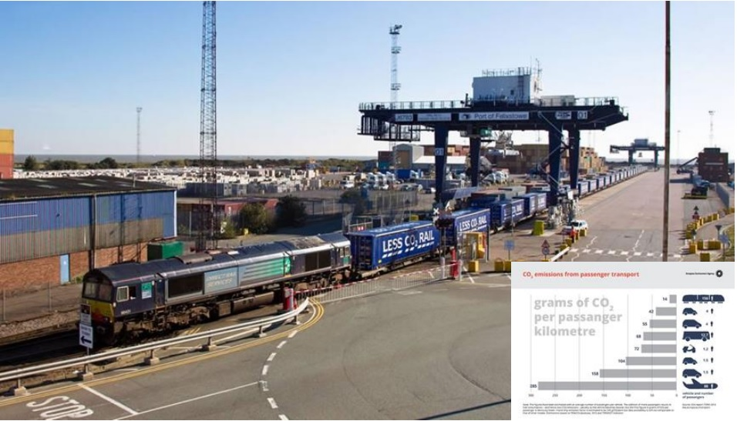
What’s so good about it?
Energy Efficient
Notes:
Rail transport is the most energy efficient way of getting around when compared with other types of transport, such as cars, planes, buses etc

Slide 5
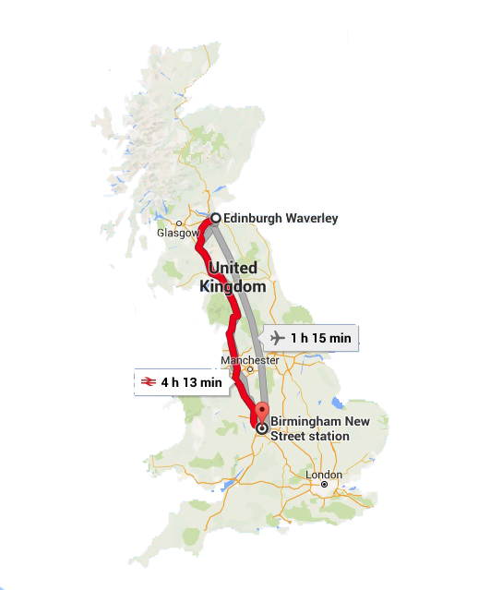
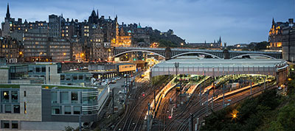
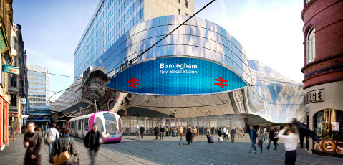
Why rail is good
Connects the hearts of different cities (Edinburgh Waverly Birmingham New Street)
Notes:
One of the advantages of commuting via trains is the fact that it has the ability to take you from a heart of one city to the other, and with modern day trains a comfort commute is priority for all passengers
Less hassle when com pared to flying Birmingham to Edinburgh for example With the train that you just hop on as soon as you arrive is entire journey would take 4h 54 mins
With a plane it would take 1h 15 mins + 1h 30 mins prior to dep that you need to be in the airport+ the time it takes to commute from the heart of the city to the airport + the time it takes for the commute from the Airport in Edinburgh to the city centre
All that combined you will find that it is much faster to commute using the train

Slide 6
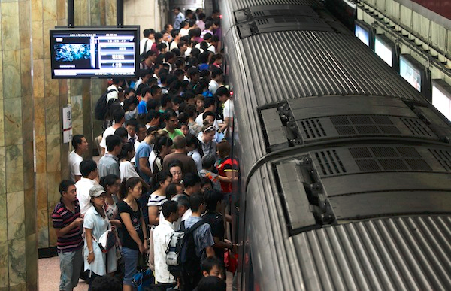
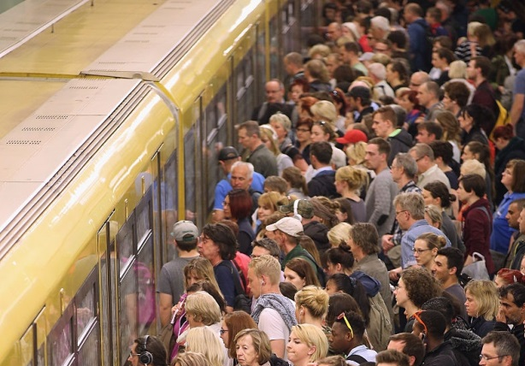
Why is rail good
It can carry a lot of people at once
Notes:
Chances are that you will always find a seat when commuting with the a train due to the simple fact that it has the ability to carry a large amount of people at any one time

Slide 7
Why is rail good
It drives our Economic growth
Notes:
Sajid Javid, Secretary of State for Business, Innovation and Skills and co-chair of the Rail Supply Group said: A strong rail sector supply chain is essential for our future productivity and the commitment to take on 20,000 new apprentices will provide opportunities for our young people to start successful careers in this vital sector
Patrick McLoughlin, Secretary of State for Transport and co-chair of the Rail Supply Group said:
We are funding the biggest rail modernisation programme since Victorian times which is creating opportunities for UK suppliers across the country We support the rail industry’s plans to strengthen our supply chain so British companies can win more work here and abroad
Rail Supply Group’s focus on developing a skilled rail workforce is very welcome Our priority is to attract the nation’s talent to the industry and to equip them with the skills to deliver on our commitment to build a world class transport infrastructure system

Slide 8
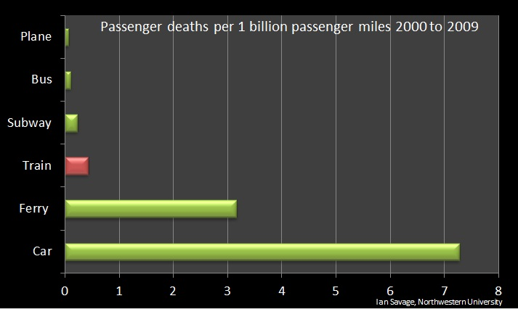
Is it so good that its safe?
Transportation over Rail saves about 950 fatalities per year compared to road
The answer is YES!!!
Notes:
According to a study taken by North western university, trains are one of the most safe modes of transport than one can use to commute (043) when compared to Cars and ferries

Slide 9
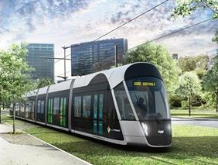
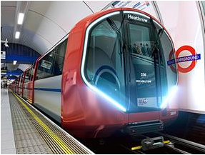
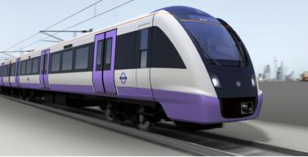
Types of trains
Tram
Mass transit
Metro

Slide 10
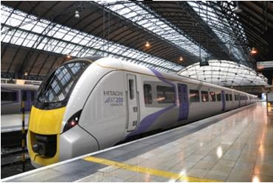
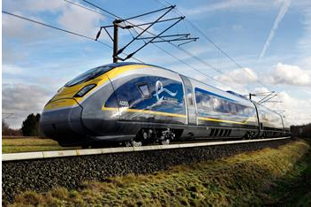
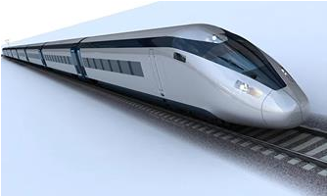
Types of trains
Extra-Urban
High Speed & Inter City
Very High Speed

Slide 11
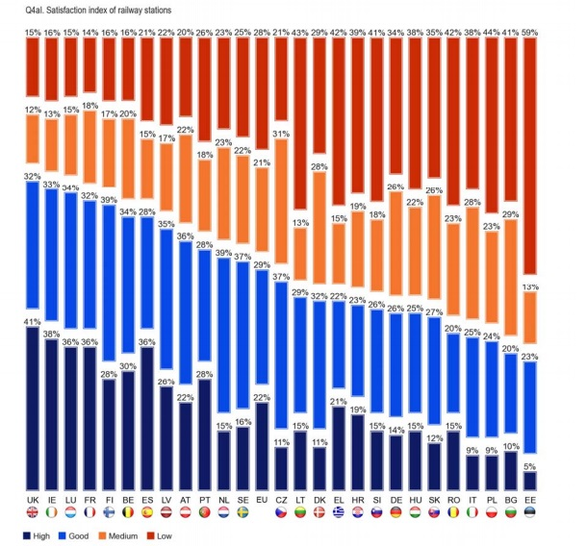
Don’t take our word for it
The UK has been Rated as the best major Railway in Europe by passenger satisfaction
We are kind of
friendly!!!
Source: EU Eurobarometer Survey
Notes:
The rail sector is not just another transport sector that just aims to get you from one destination to the other, it aims to get you from point A to point B while treating you the way you wish to be treated, hence why the UK Rail has been rated as the best major Railway in Europe for passenger satisfaction

Slide 12
Our Stations
2,539 stations in the UK
Retail Shops
Wi-Fi
Rest Areas
Advertising
Customer information systems
Transport connections

Slide 13
Industry Structure

Slide 14
Train operating companies
Major Owning Groups
Train operating companies

Slide 15
Numbers don’t lie

Slide 16
Numbers don’t lie

Slide 17
Numbers don’t lie

Slide 18
Numbers don’t lie

Slide 19
Numbers don’t lie
Long Term Committed investment
£38bn Network Rail 2014 – 2019
£42bn High-Speed 2
£15bn Crossrail
1,000+ companies in the supply chain employing 200,000 people

Slide 20
Numbers don't lie

Slide 21
What do all these numbers mean
Career opportunities
Job security
Variety of jobs
Becoming a part of HISTORY

Slide 22
Intrigued!!!
Find out what kind of career the future and Rail has in store for you by playing the career game at www.plotr.co.uk

Slide 23
Thank You

